Slide 1

McDonald's Sales Performance Case Study
Wasim Akram

Slide 2
This report analyzes McDonald's sales dashboards from January 1st and February 14th, 2023, alongside a summary of the entire year. Key performance indicators including top-selling categories, popular items, order volumes, and revenue trends are examined.
Across the dashboards, burgers consistently lead as the top-performing category, followed by chicken products, demonstrating the enduring popularity of core menu items. On January 1st, the "Breakfast Burrito" was the most frequently ordered, contrasting with the overall 2023 and Feb 14th preference for the "Big Mac". This suggests the influence of day of the week and specific promotions on product popularity.

Slide 3
Total revenue and order volume increased substantially throughout 2023, with January 1st showing $796 in revenue from 69 orders, February 14th displaying $692 from 57 orders, and the 2023 dashboard reporting $61,717 from 5370 orders. Items per order remained consistent around 2.3.
The Order Volume by Hour chart reveals peak ordering during lunch hours (12:00 PM - 2:00 PM), which is a consistent trend across the observed periods, emphasizing efficient staffing during these times. Sales by Type of Day shows varying results. January 1st sales were 100% weekend sales, February 14th's sales were 100% weekday sales, and the 2023 sales were 72% Weekday vs 28% Weekend.
In conclusion, McDonald's maintained consistent performance, driven by core menu items and operational efficiency during peak hours.

Slide 4
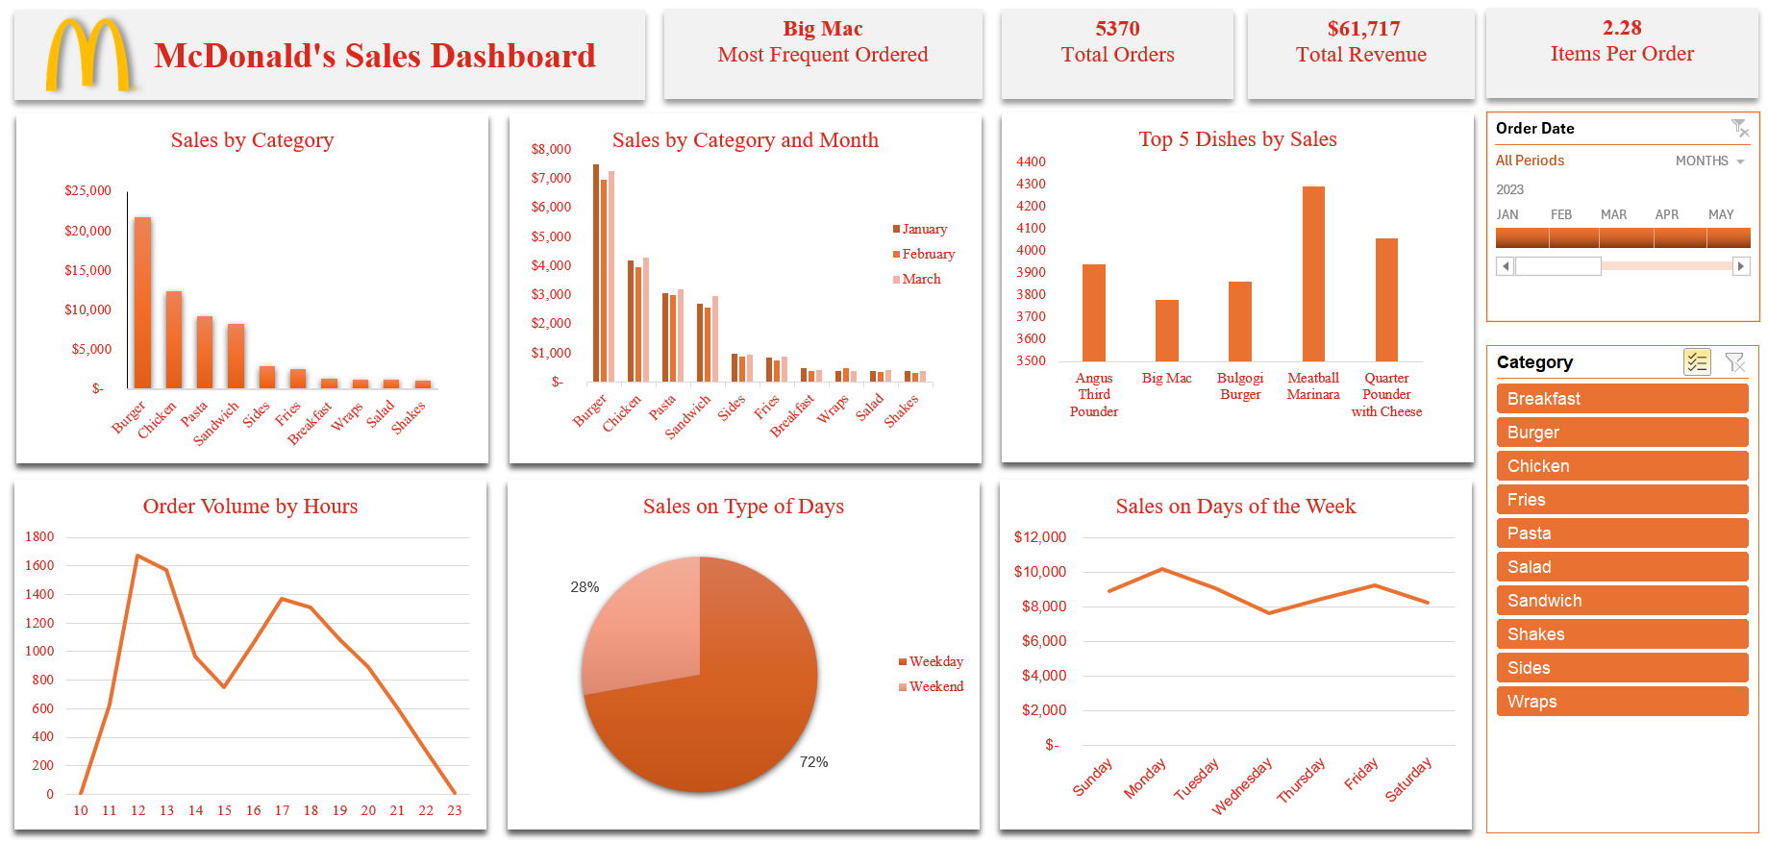
McDonald's Sales Dashboard: 2023 Overview

Slide 5
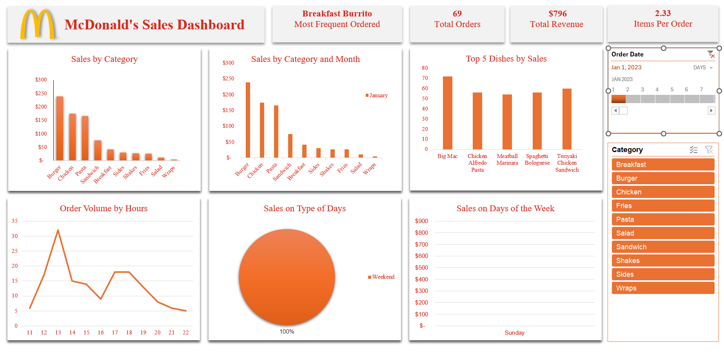
McDonald's Sales Dashboard: January 1st, 2023

Slide 6
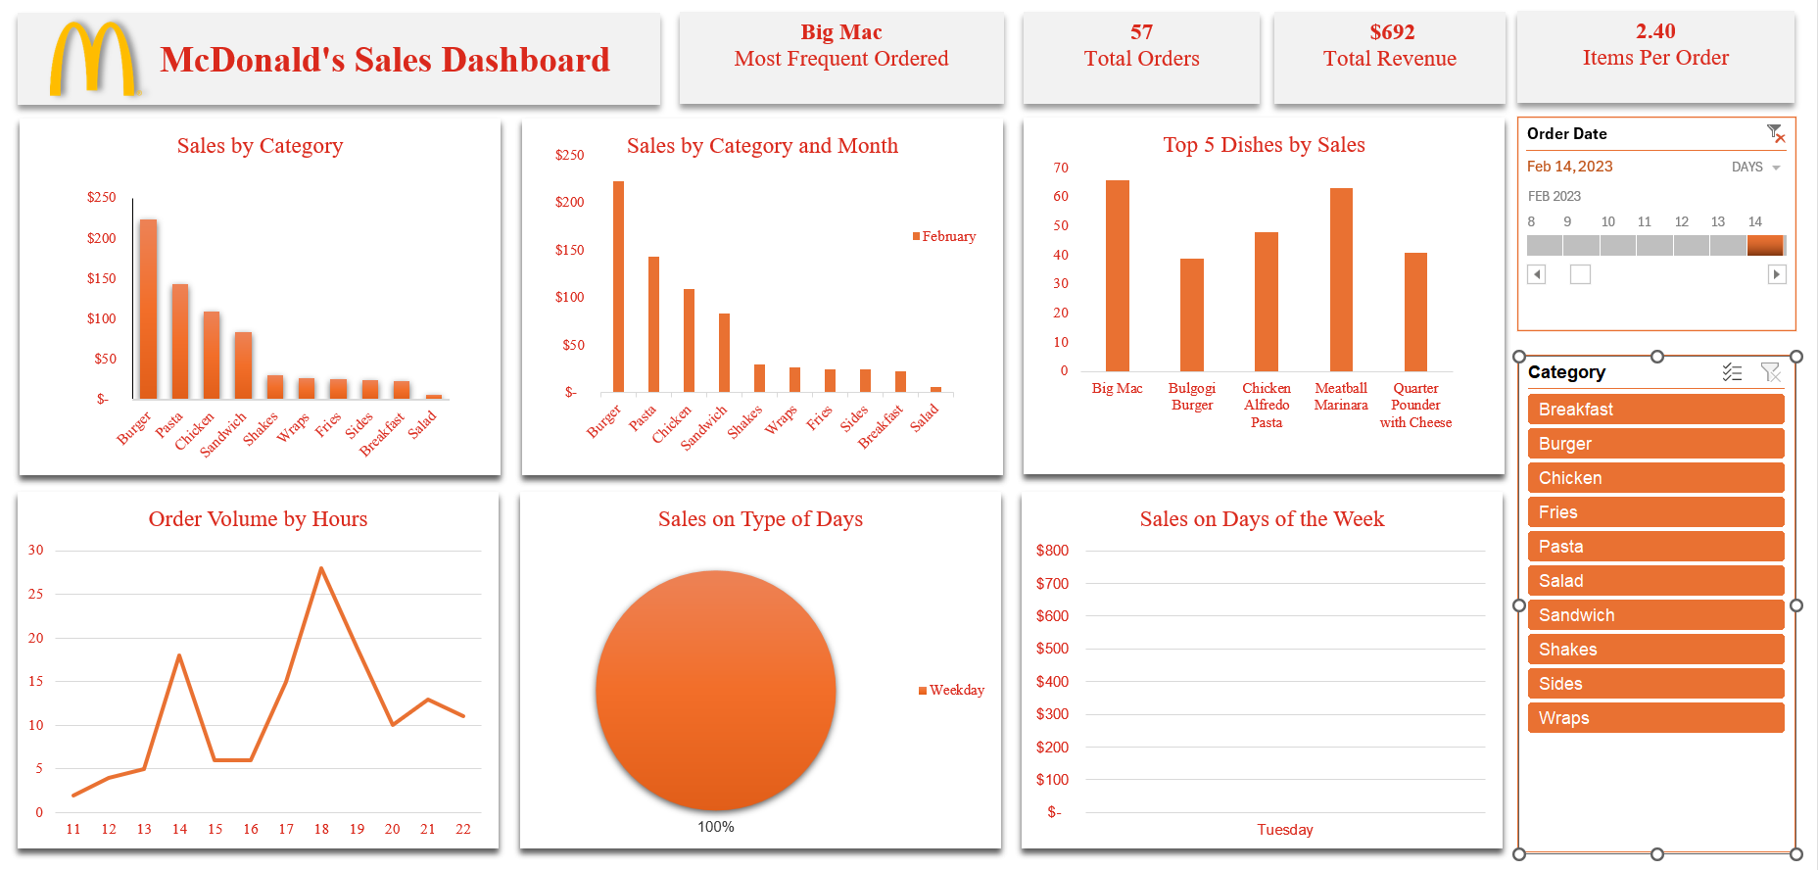
McDonald's Sales Dashboard: February 14th, 2023

Slide 7
Access the final report at Github

